Slide 1
Employee Data Analysis using Excel
STUDENT NAME:S.SAHANA
REGISTER NO: 312216122
DEPARTMENT: B.com accouting and finance
COLLEGE: shri shankarlal sundarbhai shasun jain collegeNAAN MUDHALVAN ID: 792A180B08D252A8C6C4C444D6E18ABF

Slide 2
PROJECT TITLE
Employee Performance Analysis using Excel

Slide 3


AGENDA
Problem Statement
Project Overview
End Users
Our Solution and Proposition
Dataset Description
Modelling Approach
Results and Discussion
Conclusion
3/21/2024 Annual Review

Slide 4

PROBLEM STATEMENT
The goal is to develop a pivot table that organizes employees based on their gender and assesses their current performance ratings. This analysis will enable the organization to visualize how performance ratings are distributed among different genders, highlighting any disparities or trends in employee performance. The insights gained will guide strategic HR decisions and support efforts to promote fairness and equity in performance evaluations throughout the organization.

Slide 5

PROJECT OVERVIEW
Data analytics is the practice of reviewing, cleaning, transforming, and modeling data to uncover valuable insights, draw conclusions, and support decision-making. This process uses a range of techniques, tools, and algorithms to interpret raw data, identifying patterns, trends, and correlations that can guide business strategies, enhance operational efficiency, and foster innovation. Essentially, data analytics converts raw data into actionable insights, enabling organizations to make more informed, timely, and strategic decisions.

Slide 6

WHO ARE THE END USERS?
Supervisors and Project Leaders
Human Resources (HR) Division
Senior Management
Accounting and Finance Division
Information Technology and Data Analysis Teams
Regulatory and Legal Affairs Team

Slide 7

OUR SOLUTION AND ITS VALUE PROPOSITION
Conditional Formatting: Handling Missing Data
Filtering: Eliminate Empty Cells
Pivot Table: Aggregate Employee Data Analysis
Chart: Visualization of Employee Data Insights

Slide 8
Dataset Description
Employee ID: A distinct code assigned to each employee within the organization.
First Name: The given name of the employee.
Last Name: The family name or surname of the employee.
Start Date: The date when the employee commenced their role with the organization.
Exit Date: The date on which the employee departed or left the organization (if applicable).
Title: The designation or role of the employee within the company.
Supervisor: The name of the employee's direct manager or supervisor.
Email: The email address used for official communication with the employee.
Business Unit: The specific department or business unit the employee is assigned to.
Employee Status: The current status of the employee's employment (e.g., Active, On Leave, Terminated).
Employee Type: The classification of the employee's work arrangement (e.g., Full-time, Part-time, Contract).
Pay Zone: The salary range or compensation band assigned to the employee.

Slide 9
mployee Classification Type: The category of employment classification assigned to the employee (e.g., Exempt, Non-exempt).
Termination Type: The reason for the employee's departure from the organization, if applicable (e.g., Resignation, Layoff, Retirement).
Termination Description: Specific details or explanations regarding the circumstances of the employee’s exit (if applicable).
Department Type: The general category or classification of the department in which the employee works.
Division Description: The specific branch or segment of the organization where the employee is assigned.
DOB (Date of Birth): The employee's birth date.
State: The state or region where the employee is stationed or resides.
Job Function: A summary of the primary duties or responsibilities associated with the employee's role.
Gender: A code denoting the employee’s gender (e.g., M for Male, F for Female, N for Non-binary).
Location: A code indicating the employee’s physical office or workplace location.
Race (or) Ethnicity: An identifier of the employee's racial or ethnic background, if provided.
Marital Status: The employee's current marital status (e.g., Single, Married, Divorced).
Performance Score: A rating reflecting the employee’s performance level (e.g., Excellent, Satisfactory, Needs Improvement).
Current Employee Rating: The present assessment or rating of the employee’s overall job performance.

Slide 10

THE "WOW" IN OUR SOLUTION
interactive Data Filtering:
Dynamic Filtering: Instant updates as you adjust filters.
Multiple Slicers for Comparative Analysis:
Side-by-Side Comparison: Easily compare different datasets simultaneously.
Accessibility and Ease of Use:
User-Friendly Interface: Intuitive and easy-to-navigate design for all users.
3/21/2024 Annual Review
10

Slide 11
MODELLING
Data Collection: The dataset was downloaded from Kaggle.
Feature Selection: The database includes 26 features, of which I selected 4 to use for my project.
Data Cleaning: During this phase, I identified and addressed missing values and removed any blank entries.
Summary: For the project, I utilized pivot tables to analyze employee data and employed the slicer tool to categorize employees by their employment type (Contract, Full-time, Part-time).
Visualization: I created a pie chart to represent and visualize the findings from the employee data analysis.
11

Slide 12
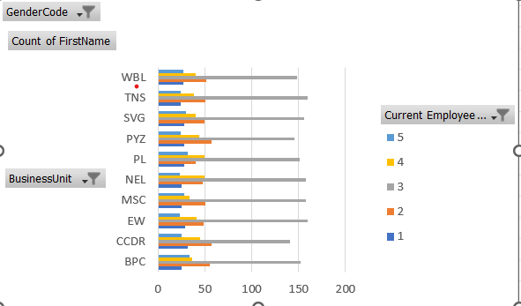
RESULTS
12

Slide 13
conclusion
This project has effectively analyzed the Employee dataset. The performance analysis, performed using Excel, offers significant insights into how employee performance is distributed and evaluated across different factors like gender, department, and job level.
By utilizing Excel's advanced features, including pivot tables, slicers, and conditional formatting, we transformed raw data into insightful summaries. This approach revealed trends and disparities that might have otherwise remained hidden.

